Slide 1

What is QPI?

Slide 2
Today’s Objectives
Develop a basic understanding of QPI as a system change Strategy
Be able to explain the answer to “What is QPI” to another person

Slide 3
What is QPI
QPI, the Quality Parenting Initiative, is a national movement for foster care change, made up of a network of states, counties and private agencies committed to ensuring that all children in care have excellent parenting and lasting relationships so they can thrive and grow.
QPI is built on the belief that excellent parenting with strong, positive relationships is the best intervention we can offer children to enable them to heal as they grow up to become adults. Creating a system that ensures excellent parenting requires the support and involvement of birth families, relative caregivers, foster families, young people, and others in the child welfare system.
Research has demonstrated that children and youth need consistent and effective parenting to thrive. When parents cannot care for their children, another caregiver, in partnership with the child welfare system, must be able to provide loving, committed, and skilled care that enables the children to feel trust in their relationships with the adults in their lives.

Slide 4
Values
KNOWLEDGE of the law, research and the facts on the ground
INTEGRITY to do what is best for our clients regardless of financial or social consequences to ourselves and to deserve the trust of our supporters and clients
We advocate for children in care as if they were our own, with…..
COMMITMENT to pursue solutions urgently and relentlessly
RESPECT for the individuality of children and families and their potential to thrive and for the efforts of those who strive to serve them.

Slide 5
A Change in Mindset:
QPI
CORE
Principles
Consistent excellent parenting and meaningful relationships are the most important services we can provide to children and youth in foster care. Every policy, practice action, and statement the system adopts should strengthen parenting skills and relationships.
Research on child, youth, and brain development and the effects of trauma not only demonstrates the importance of parenting and positive relationships but also provides guidance on how best to support them. Agency policy and practice should be informed by research.
The individuals most affected by policies and practices are in the best position to design and implement change so that systems ensure excellent parenting and meaningful relationships for children who enter their care.

Slide 6
KEY ELEMENTS:
Defining the expectations of and by caregivers,
Clearly communicating these expectations to all staff, caregivers, and other stakeholders, as well as the general public, and
  What can be shared?
Aligning system policy and practice with those expectations

Slide 7
QPI Core Principles

Slide 8
QPI Theory of Change
GRASSROOTS MOVEMENT.
1. People who do the work know what needs to be changed and how to change it.
2. People are loyal to the things they create.
3. People will implement when they understand why they are implementing.

Slide 9
Discussion Question #1
What’s in it for me?
  QPI impacts each role of the child welfare system differently.
  Let’s brainstorm the value of this change for each group.
  Role Cards

Slide 10
Discussion Question #2
Issue Spotting:
  What are the most pressing challenges that undermine excellent parenting?
  How do you know?

Slide 11
Three ways we QPI:
Comfort calls
Icebreaker Meetings
Well planned transitions

Slide 12
Comfort Calls
Reduce trauma for children when first placed in a new out of home placement.
Equips parents to connect around the unique needs and preferences of the child(ren).
Builds shared parenting that will support the child(ren)/youth.
Children and youth do their best when there is strengthened communication and relationship between their caregivers.

Slide 13
Goals of the comfort call
 Set the stage for partnership and co-parenting between the birth family and foster family.
 Open the door for birth and foster families to ask questions to one another that support the child/youth during the difficult time of initial separation.
 Encourage and invite everyone to attend the Circle of Support Meeting.

Slide 14
Icebreaker Meetings
• Reduce the trauma of foster care placement for children;
• Introduce parents and caregivers in order to share information;
• Build alliances among adults when children are in congregate care, too;
• Begin relationship building and a sense of teamwork; and
• Improve everyone’s ability to help a child, including the caseworker.

Slide 15
Transitions
Planful Transitions are the thoughtful, collaborative processes, and actions designed to ease the trauma for a child, to maintain established attachments and connections, and to facilitate attachment with a new caregiver and a successful move. A planful transition means that those responsible for the child’s well-being (e.g. DCFS, foster parents, biological parents, judge, attorney, providers, etc.) work together to ensure that the child’s move is a smooth one. Each plan must be individualized to each child specifically considering his/her unique circumstances, developmental stage, psychological needs, safety, and attachment to current and future caregivers.
Transition Plans should be developed whenever a change of caregiver is being contemplated for a child. That includes removal from a birthparent, change of foster caregivers or placements, and permanency moves of reunification, adoption, guardianship and all other permanency plans. These Planful Transitions are critical to maintain attachments and support successful outcomes for children when they move.

Slide 16
Why Transitions matter:
Never get to say goodbye
Grief
Cause more trauma

Slide 17
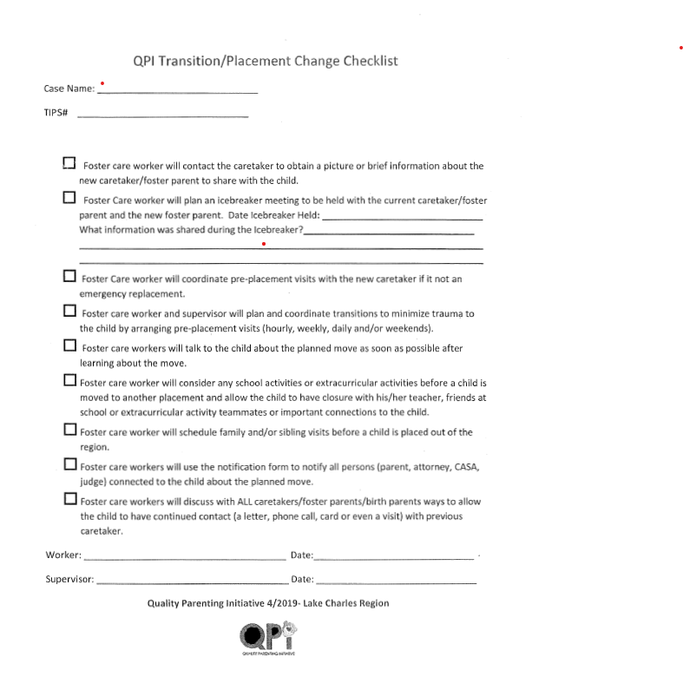

Slide 18


Slide 19
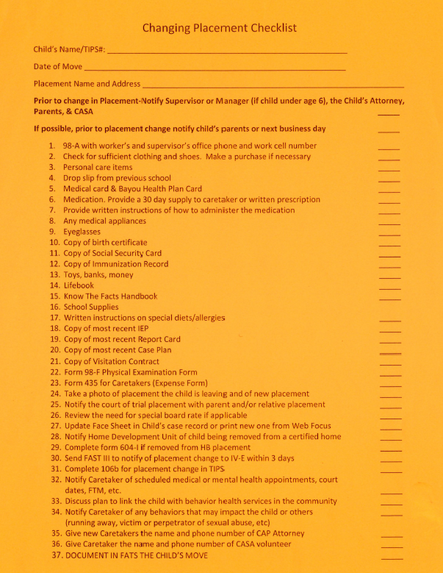

Slide 20
HOMEWORK
Explain QPI to a friend familiar with the child welfare system
      What did you find easy to explain?
      What did you find challenging to explain?
      What support do you need to effectively and confidently explain QPI?

Slide 21
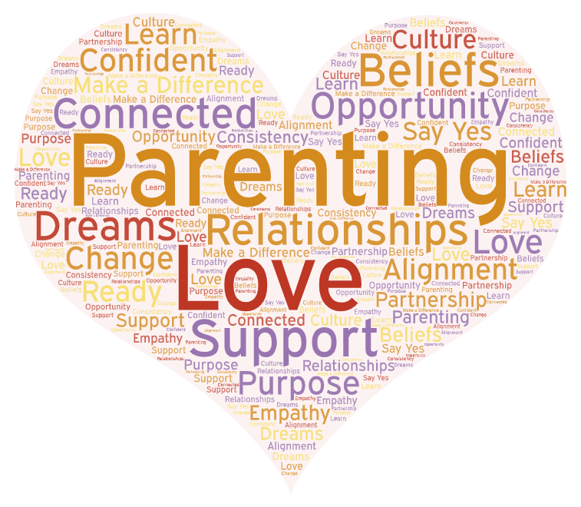
CONCLUSION

